Slide 1
Barriers and Solutions to the adoption of diagnostic technologies
Sally Chisholm, Programme Director, Adoption and Impact

Slide 2
Discussion Today
Innovation, the name of the game
Real World Examples
  Coaguchek
  Calprotectin
  Telestroke
Learning from NICE about developing technologies

Slide 3
My role at NICE
The Adoption and Impact team has three roles:
Helping the NHS and social care to adopt proven NICE recommended technologies more quickly.
Measuring, assessing and reporting their uptake.
Assessing the resource impact of recommended technologies and devices.

Slide 4
Adoption Team
Work with NHS and social care organisations to implement medical technologies and diagnostic tests.
Developing documentation to support the wider system in the adoption of the technologies

Slide 5
Characteristics of Innovation
Novelty
An application component
An intended benefit
Lansisalmi et al 2006

Slide 6
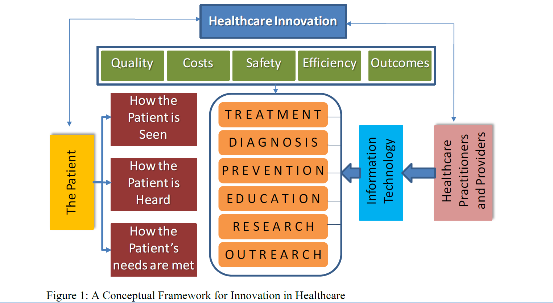
Innovation in Healthcare Delivery Systems
Omachonu & Einspruch. 2010

Slide 7
Stakeholders in the Innovation process
Stake Holders | Needs, Wants & Expectations
Physicians and Other Care Givers | Improved clinical outcomes, improved diagnosis and treatment
Patients | Improved patients’ experience, improved physiological well-being, reduced waiting time, reduced delay
Organisations | Enhanced efficiency of internal operations, cost containment, increased productivity and quality and outcomes improvement
Innovator Companies | Profitability, improved outcomes
Regulatory Agencies | Reduced rises and improved patient safety
Omachonu & Einspruch 2010

Slide 8
NHS Five Year Forward View
Barrier or Solution?
3 Gaps to close
  Health and Wellbeing Gap. Prevention to fund beneficial new treatments
  Care and Quality Gap. Harness technology reshape care delivery
  Funding and Efficiency Gap.
Why use Diagnostics?
NHS needs to make 1.5% efficiency every year until 2020
70% of NHS budget is spent caring for people > 65 years old and 60% of them have chronic illnesses

Slide 9
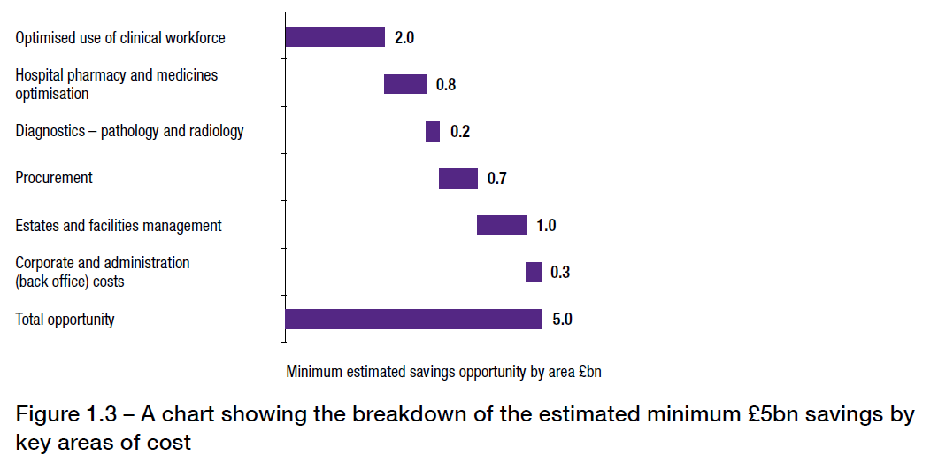
Carter Report – Solution or Opportunity?
Decreasing unwarranted variations in NHS hospitals felt to offer a £5 billion efficiency
    Average price paid for hip prosthesis varies from £800 to £1700, those buying the most are not paying the lowest price

Slide 10
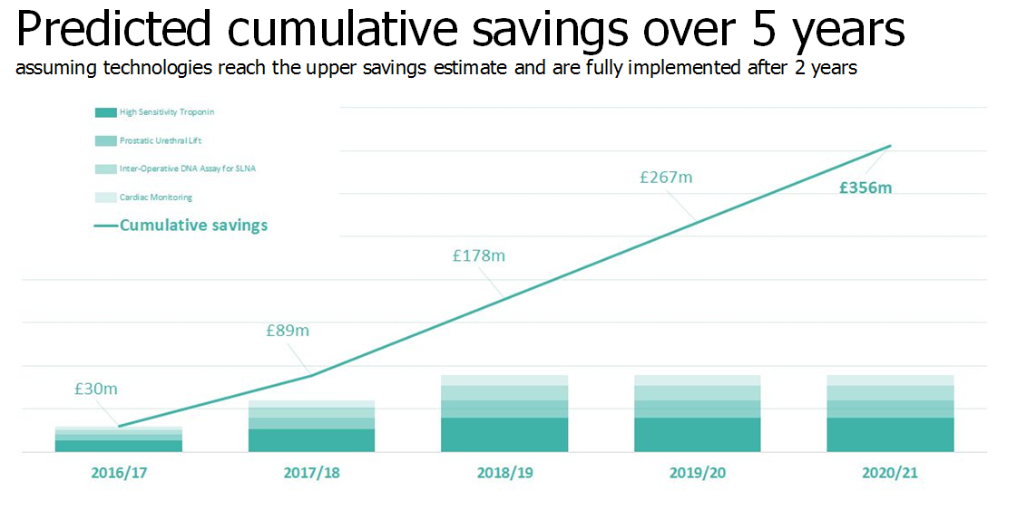
Technology Contribution of Innovation

Slide 11
Measuring Change
Innovation Scorecard - helping the NHS to identify variation in the adoption of NICE recommended products
Defined daily doses of apixaban, dabigatran etexilate and rivaroxaban. Primary care prescribing trend (April 2011 – September 2015)

Slide 12
National Audits
Implant rate per million population for new implantable cardioverter defibrillators and cardiac resynchronisation therapy . Cardiac Rhythm Management audit

Slide 13
Whole Systems Demonstrator
Largest randomised control trial of telehealth and telecare. Over 3000 patients (diabetes, Heart Failure & COPD in 238 GP practices. Reported in 2011
Question – Does the use of technology as a remote intervention make a difference?

Slide 14
Whole Systems Demonstrator
Telehealth delivered:-
  15% reduction in emergency visits
  20% reduction in emergency hospital admissions
  14% reduction in planned admissions
  14% decrease in bed days
  8% reduction in costs
  45% reduction in mortality

Slide 15
Faecal Calprotectin (DG11 & QS81)
DG11 October 2013 - faecal calprotectin testing recommended by NICE as an option to help distinguish between inflammatory and non inflammatory bowel diseases.
QS81 (IBD) February 2015 - faecal biomarkers, such as faecal calprotectin, alongside clinical assessment may be useful in primary care to distinguish between suspected inflammatory bowel disease and non‑inflammatory bowel disease, such as irritable bowel syndrome

Slide 16
NICE Adoption Project
The NICE Adoption team worked with AHSNs to identify NHS organisations interested in evaluating the impact of introducing faecal calprotectin testing for inflammatory diseases of the bowel into primary care.
Two sites were selected to participate. They each proposed different approaches to their intended adoption of faecal calprotectin testing. NICE did not stipulate the technology to be used or the method of testing.

Slide 17
Sites
York Teaching Hospital NHS Foundation Trust and NHS Vale of York Clinical Commissioning Group
St George's University Hospitals NHS Foundation Trust and NHS Wandsworth Clinical Commissioning Group

Slide 18
York
Project team - consultant gastroenterologist (project lead), CCG GP lead for planned care, CCG innovation and improvement manager, laboratory lead and deputy directorate manager for acute and general medicine.
Guidelines and treatment algorithm for people aged 18-60 for FCP testing in primary care for GPs in 5/30 practices.
6‑month pilot project, followed by an evaluation of the local guidelines.

Slide 19
Wandsworth
Project team - consultant gastroenterologist (project lead), CCG GP lead, laboratory leads, pathology project manager.
Pathway algorithm developed for people aged 16-40 for FCP testing in primary care for GPs in all 43 practices.
5-month pilot project with review of algorithm.

Slide 20
Pathway for FCP results
York:
  <100 mcg/g – IBS likely. Treat locally and review at 6 weeks.
  100–250 mcg/g – stop NSAIDs and repeat in 2 weeks.
  >250 mcg/g – refer for urgent colonoscopy.
  Wandsworth:
    <50 mcg/g – consider IBS with alternative diagnoses and manage in primary care.
    >50 mcg/g - refer for investigation for IBD.

Slide 21
Results – York
FCP (mcg/g) | IBS | IBD | Other | Unknown | Total
<100 | 190 | 0 | 22 | 9 | 221
100–250 | 13 | 1 | 2 | 1 | 17
>250 | 15 | 8 | 8 | 0 | 31
TOTAL | 218 | 9 | 32 | 10 | 269
FCP (mcg/g) | GP | Gastro OPD | Investigation# | Unknown | Total
<100 | 145 | 20 | 46 | 10 | 221
100–250 | 4 | 0 | 11 | 2 | 17
>250 | 1 | 0 | 30 | 0 | 31
TOTAL | 150 | 20 | 87 | 12 | 269
#Endoscopy, MRI or CT scan
Notes:
Top table shows that no one with a normal faecal calprotectin result had IBD. An intermediate result was also a low indicator of IBD (1/17, 5.9%). However, one quarter (25.8%, 8/31) of people with a high faecal calprotectin test result had a final diagnosis of IBD.
Bottom table shows:
65.6% of people (145/221) with a normal test result <100 were diagnosed and managed in primary care.
85.4% of people (41/48) with an intermediate or high test result were diagnosed following specialist secondary care investigations.

Slide 22
Solutions & Barriers - York
If testing were rolled-out across the CCG this would result in more than 2000 requests per year.
GPs reported a high level of trust in the test results with most agreeing that the testing had been useful in making their clinical decision.
With guidance, the test is useful for identifying people with a low risk of IBD, but who have functional disorders that can be managed appropriately in primary care.
The project team considered that GPs need greater awareness of the limitations of the test, how to manage the results, when to refer a patient to secondary care and with what urgency to make the referral.

Slide 23
Solutions and Barriers - Wandsworth
29/43 practices made requests for 269 people.
23% had an abnormal result
The project team were unable to show whether FCP testing could reduce the CCG's lower gastrointestinal endoscopy workload for a number of reasons:
  Not all practices in Wandsworth CCG participated in the project.
  Year‑on‑year growth in referrals may be greater than the reduction in referrals following FCP testing.
  FCP testing may not influence a GP's decision to refer a patient for specialist assessment.

Slide 24
Adoption tips
Before implementation, collect baseline data and agree metrics to be collected during and after implementation.
Consult all stakeholders to ensure clinical confidence in using FCP testing in both primary and secondary care.
Consider implementing FCP testing on a pilot basis in a limited number of practices.
Ensure that care pathway mapping has been done to identify where the technology would fit into the proposed patient pathway.
Agree cut‑off values and subsequent local referral pathways to maximise the benefit of the test.
Clearly define the patient selection criteria and how many patients will be expected to benefit.

Slide 25
Coaguchek XS System (DG14)
County Durham and Darlington NHS Foundation Trust
Aim:
Use telehealth projects to address capacity issues
Objectives:
International normalised ratio (INR) self-testing to be the first clinical pathway to be automated and digitised
Improve patients lifestyle outcomes
Improve the patients’ time in therapeutic range
Increase time spent with more complex patients through effective digital triage

Slide 26
Service Model
Call 1:
On the agreed day of the INR test the individual measures their INR using the CoaguChek XS meter.
At their preferred time they receive an automated call on their nominated UK mobile or landline number and are asked to enter their INR reading, current warfarin dose, and have to answer 3 questions around bleeding and medication.
The INR results, and any clinical alerts generated by their responses, are sent to the warfarin clinic through the automated portal.
Using anticoagulation software and clinical judgement, their warfarin dose and date of next INR test is determined.
The dosing regime and date of next INR test is then entered into the portal by the member of staff.
Call 2:
The person then receives another automated call which instructs them on their warfarin dose and the date of their next INR test.

Slide 27
Time in Therapeutic Range
 | Cohort 1 | Cohort 2
Number of people in cohort | 100 | 100
Recruitment selection criteria | Narrow Most were hand-picked by staff | Broad Most were recruited from advertisements
TTR 6 months before (%) | 60.4 | 59.0
TTR 3 months before (%) | 58.9 | 59.0
TTR 3 months after (%) | 72.8 | 71.0
TTR 6 months after (%) | 74.4 | 75.0
The drop-out rate was relatively low (17 people: 2 moved area, 4 died (due to non-related reasons), 5 had difficulty due to frailty, 5 stopped warfarin treatment, 1 returned to clinic).

Slide 28
Results and Evaluation
Service user feedback was extremely positive with comments typically being around:
  Reduced time attending clinics
  Less impact on work disruption and money lost from taking holiday or no pay to attend clinic
  Money saved from travel costs and parking
  Ability to test whilst working away from home or on holiday
  Flexibility

Slide 29
Barriers and Solutions
Operational: it increases capacity of existing clinics
i) Include the anticipated costs of extra clinics needed to address growing need
ii) Proposed integration with dosing software to reduce clinician time needed per telehealth patient and reduce transcribing error risk
Clinical: it improves clinical outcomes
Self-testing has improved time in therapeutic range by 20% for 70% of patients

Slide 30
Barriers and Solutions
Financial: it is cost neutral when all CCG costs are included
i) Include savings from the known reduction in adverse events
ii) Avoid large capital spend by using a rental scheme for meters
iii) Focus on the 20% of warfarin patients whose monitoring is the most expensive (that is, people who are house-bound and those who attend satellite clinics)
Strategic: it supports Department of Health and NHS England objectives
i) Improves quality of life for people with long-term conditions
ii) Patient satisfaction for INR self-testing is close to 100%

Slide 31
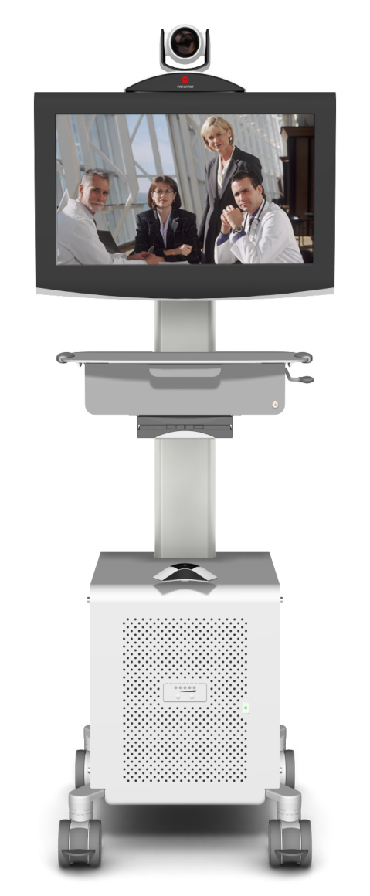
What is Telestroke?
Real-time video conferencing
Allows “face to face” two way consultation with a remote stroke specialist and a patient
Access to radiology images

Slide 32
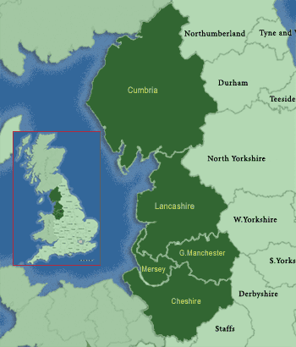
Carlisle
Whitehaven
Barrow
Lancaster
Blackpool
Blackburn
Preston
Southport
Cumbria & Lancashire Telestroke Network
Notes:
Each year in Lancashire and Cumbria about 4000 patients will have a stroke and about 1200 will have a stroke-like episode for which an alternative diagnosis is eventually reached.
This figure is not SMR adjusted and will in fact be higher. Only 20 patients in the Network received thrombolysis last year.
Potentially 400 patients could be eligible and this figure could increase as the evidence base for a wider time window strengthens and public awareness grows.

Slide 33
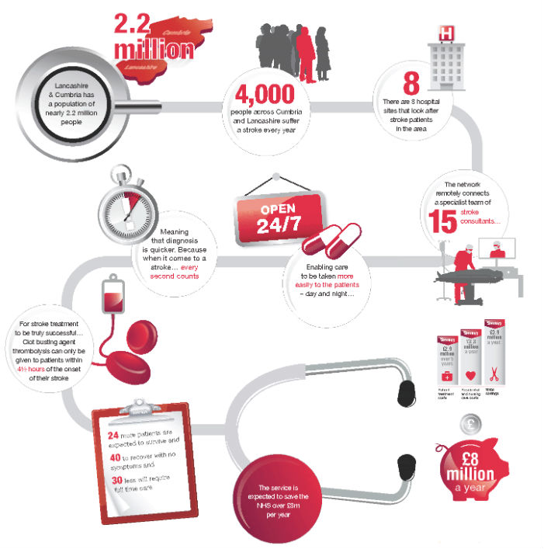
Telestroke Model
VirginMedia

Slide 34
Solutions
Out of hours solution to catch the 60% of patients missed by 9-5 services
Collaboration of 6 Acute Trusts (8 sites) and 7 PCTs
Virtual rotating hub of 15 stroke physicians with uncontested broadband capability at home
Combination of remote teleconsultation and teleradiology in the ED and consultant’s home
Bringing the specialist to the patient

Slide 35
Impact in the first 12 months
24 Patients alive that would probably have died
40 Had no symptoms or disability on discharge from hospital
30 people had decreased dependency
Saved the Health and Social Care budget
£ 8 million

Slide 36
Experiences of front-line health professionals in delivery of Telehealth
32 Nurses and Doctors - Mixed views from professionals
  Nurses more positive when supplementing not substituting their roles
  Nurses felt it improved their knowledge and skills
  GPs concerned about increasing work and undermining professional autonomy
  Professionals felt patients saw a correlation between their behaviours and their biometric signs
  Concerns that patients being medicalised
  MacNeill et al (2014)

Slide 37
Questions to consider when developing new technologies
Potential Usage
What problem is your technology trying to solve?
Have you identified the potential usage of your technology in terms of the eligible patient population?

Slide 38
Comparators and Acceptability
Have you identified all potential comparators and assessed their current uptake and use in the market?
Have you evidence on the acceptability of and confidence in your product to patients and clinicians

Slide 39
Care Pathways & Patient Selection
Would your technology fit into a current care pathway as an alternative to a current technology or treatment or would service / pathway redesign be required?
Are there any issues around patient selection?
Is the patient population, disease area or clinical problem clearly defined?

Slide 40
Resource Impact
Have you considered the resource impact of your product in the market in terms of procurement, and payment?
Is the product likely to be considered a high cost device?
Does your technology use consumables that need to be factored in to cost?

Slide 41
Risk management and governance
Does the technology require acceptance testing?
Are there any patient or operator safety issues?
What is the lifespan of the technology?
Is specialist training required to use the technology? What is the cost?
Are quality control procedures needed?
How is the technology maintained? (frequency/who and cost?)
Do system components need scheduled replacements?
Are there specific storage arrangements?

Slide 42
Solutions for Barriers
Leadership and Vision
Clarity of Organisational Goals
Organisational structure and processes
Strong commissioning skills
Governance and accountability
Project and programme management
Communication
Staff and Patient Empowerment
Clark and Goodwin 2010

